Slide 1

POORNIMA COLLEGE OF ENGINEERING DEPARTMENT OF INFORMATION TECHNOLOGY
Industrial Training Presentation on
“Front End Web Development”
Carried Out At
Bussibees Ed-tech Pvt Ltd
Session: 2024-25
Presented to:
Ms. Priya Shekhawat
Mr. Alok Singh
(Faculty Coordinators)
Presented By:
Student Name: Joyesh Santra
Reg. No.:PCE23IT025

Slide 2
Content
Introduction to Company (Include Company Name, Domain Area, Size of Company, Place, Background of Company, images etc)
Prerequisites of the Training
Training Description (Training Instructor’s Name and Profile)
Technology Used (With Details)
Topics
Description
Project Description (wherever applicable)Hello
Snapshots of Project (wherever applicable)
Conclusion and Future Scope
References

Slide 3

Introduction to Company
Company Name: Bussibees Ed-tech Pvt. Ltd.
Address: Baba Vidhan Sabha Nagar, Patrakar Rd, near Orient Residency, Jaipur, Rajasthan.
Founder Name: Mr. Rahul Gamot ( a visionary entrepreneur, laid the foundation of Ed-Tech in Jaipur on 5 September 2010)

Slide 4
Introduction to Company
Director Name: Er. Suman Gamot
HR Name: Mr.Neeraj Sharma
Training Domains: 20+
Aspirants Trained: 150K+
No. of Centres: 2 (Jodhpur & Jaipur)
No. of Batches: 100+ live batches
Website: www.bussibees.com

Slide 5

Prerequisites of the Training
HTML
HTML stands for Hyper Text Markup Language. It is used to design web pages using a markup language or it is the foundation of any web page. HTML is a combination of Hypertext and Markup language. Hypertext defines the link between web pages. A markup language is used to define the text document within the tag which defines the structure of web pages.. Learn the best practices for writing semantic HTML, including proper use of headings, lists, and forms.
CSS
CSS is used to style and layout web pages. CSS stands for Cascading Style Sheets. It is a style sheet language which is used to describe the look and formatting of a document written in markup language. It provides an additional feature to HTML. It is generally used with HTML to change the style of web pages and user interfaces. CSS is used along with HTML and JavaScript in most websites to create user interfaces for web applications and user interfaces for many mobile applications.

Slide 6
Training Description
Time Period: 15 Days
Starting Date: 11 July 2024
Ending Date: 26 July 2024
Working Hours: 5 hours/day
Location: Jaipur, Rajasthan
Address of the Company: Baba Vidhan Sabha Nagar Patrakar rd near Orient Residency, Jaipur, Rajasthan - 302020
Training Coordinator: Mr. Shiryansh Sharma
Designation: Trainer
Training Coordinator Email: shiryansh7012@gmail.com

Slide 7
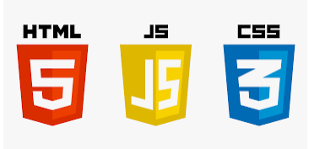


IDE Used
Technology Used
HTML
CSS
JavaScript
VS Code
Notepad

Slide 8
Topics
Introduction
Document Structure
Attributes
List
Selectors
Box Model
Typography
Colors and Backgrounds
Layout

Slide 9
Description
HTML
Introduction
Document
Structure
Attributes
List
Anchor
Element
Image
Element
Webpages
Week 1

Slide 10
Description
CSS
Introduction
Inline
Internal
External
Selectors
CSS Colors
Font Properties
Box Model
Layout
Week 2

Slide 11
Project Description
Project Name: Music Player
Project Coordinator: Shiryansh Sharma
In this Music player you can play your favourite music .

Slide 12
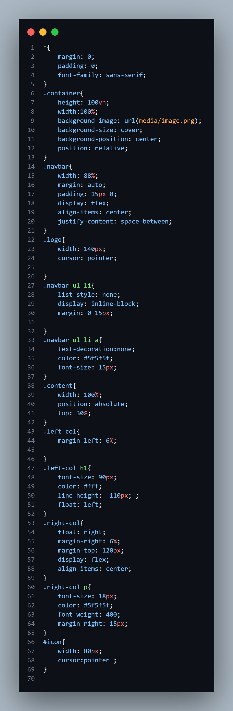
Source Code

Slide 13
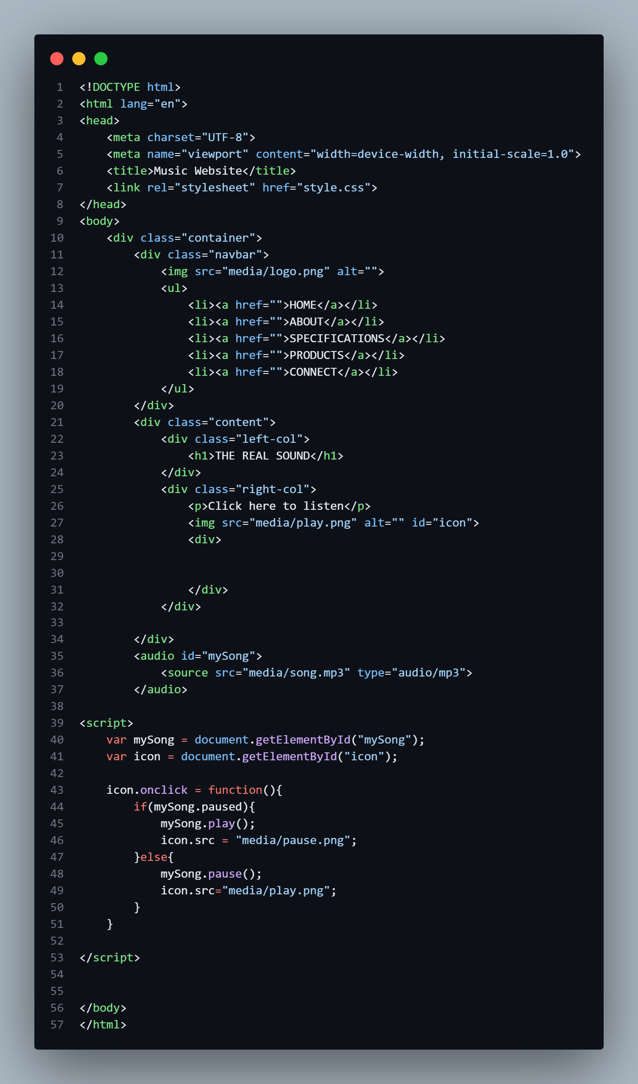
Source Code

Slide 14

Snapshot of Project

Slide 15

Snapshot of Project

Slide 16
Conclusion and Future Scope
Conclusion :-
In conclusion, a music website serves as a dynamic and versatile platform that brings together artists, listeners, and industry professionals. It facilitates the discovery of new music, promotes emerging talent, and offers a wide array of music-related services and features such as streaming, downloads, playlists, and social interaction
Future Scope:-
The project has demonstrated the effectiveness of a music player. In future we will likely introduce playlist and more music option for this project.
References:-
https://developer.mozilla.org/en-US/
https://www.geeksforgeeks.org/
https://w3schools.com/
https://devdocs.io/

Slide 17
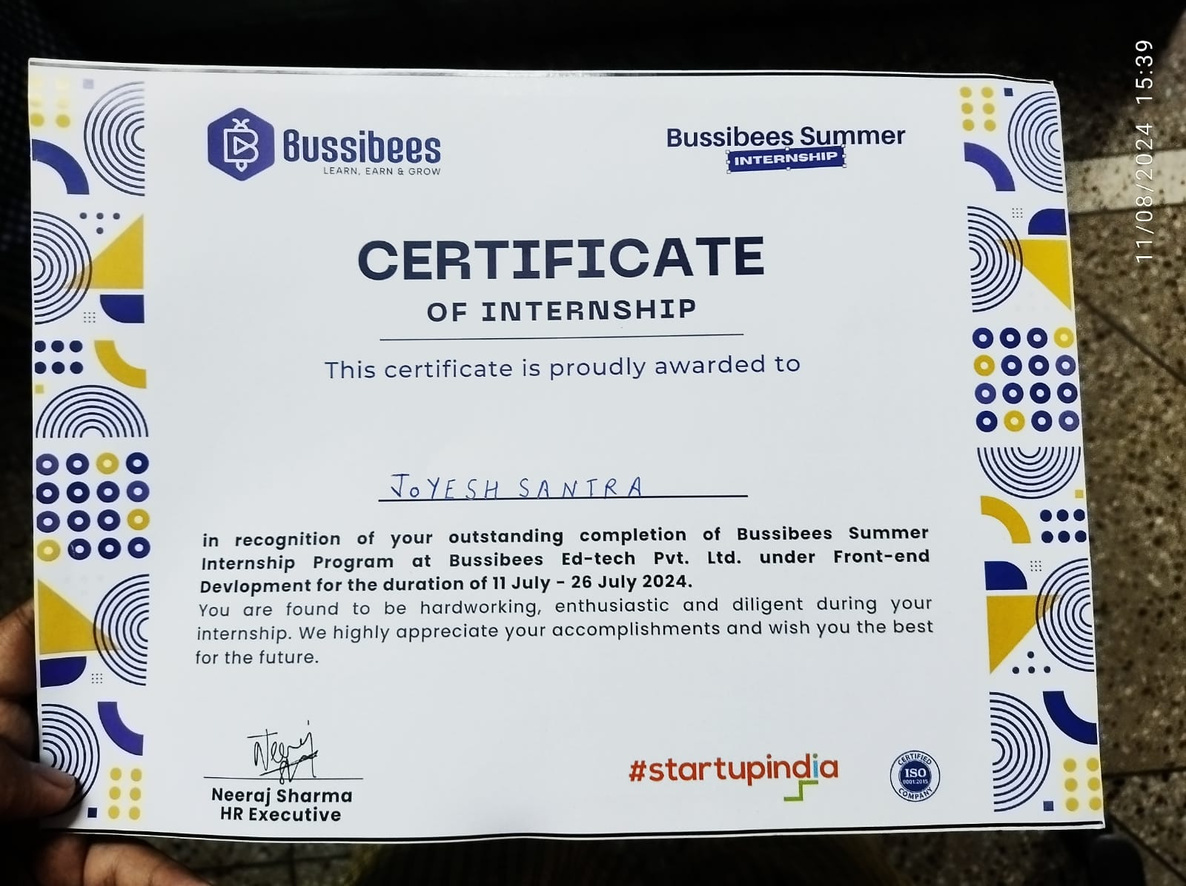
Certificate

Slide 18


